Slide 1
Face Recognition using OpenCV
By: RGIT Robotics Club

Slide 2
A Quick Recap
Python Basics
Introduction to OpenCV
Contours
Image smoothening

Slide 3
INTRODUCTION
A facial recognition system uses biometrics to map facial features from a photograph or video. It compares the information with a database of known faces to find a match.
It can be done using either an imported video or a live feed from the webcam.

Slide 4
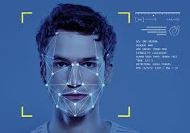
Today’s Agenda
Introduction to Google Colab
Face detection using deep learning
Face recognition

Slide 5
A few misconceptions
Most often confuse Face Detection and Face Recognition codes.
Face detection is just locating a face in the given input
Face recognition is differentiating two or more faces
Recognition may also include comparing them to a database and naming the detected faces

Slide 6
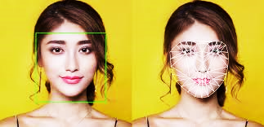
Face detection
Face Recognition

Slide 7
Applications
Face recognition is widely used from Unlocking your phone or laptop to taking attendance
College projects:
Attendance
Professional use:
Security
Traffic rules enforcer
Car unlock(a supposed future use)

Slide 8
Process of Face Recognition
Step 1: Find all the faces
Step 2: Analyze facial features of each face
Step 3: Encoding faces
Step 4: Comparing them to know faces

Slide 9
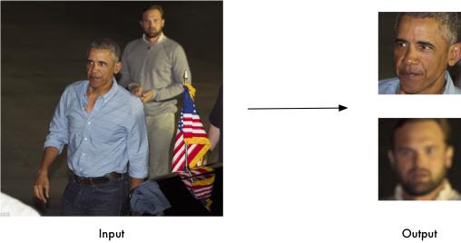
Finding all the Faces
All the faces in a picture or video frame are detected
Each face is saved separately for step 2

Slide 10
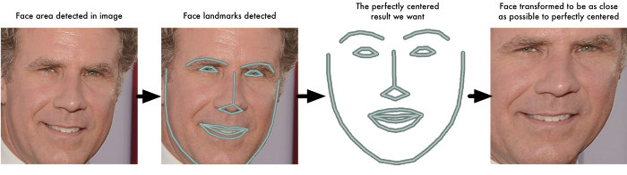
Analyzing facial features
Facial features are analyzed with the help of Neural networks
Every feature is recorded in its layers and later put together for out put
68 different spots(landmarks) which exist on each face are marked on a face
These are then aligned in a centered position(Bad lighting or angle would not affect the result)
Read the face
Spotting landmarks
Landmarks are recorded
Center aligned face

Slide 11
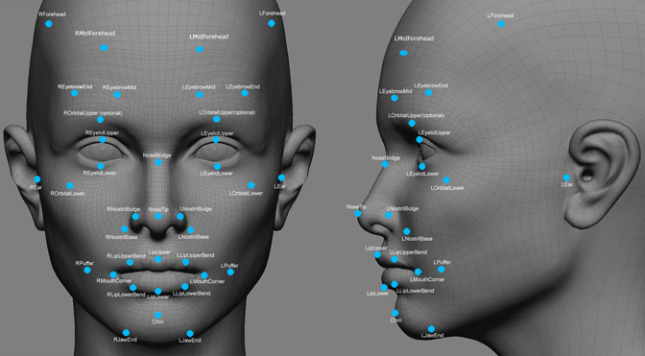
Encoding the faces
The output of Neural networks is the 128-d real time vector
Landmarks just record basic features present in any face
Encoding includes finding differences
Every feature has its own fixed set of values
A combination of these values defines a face

Slide 12
Comparing to Known faces
We could use SVM classifier algorithm or K-NN triplet training
Triplet training is a training model of K-NN
It is used to check the accuracy of the program(usually 98.83%)
2 pictures of same person, and 1 different

